Slide 1
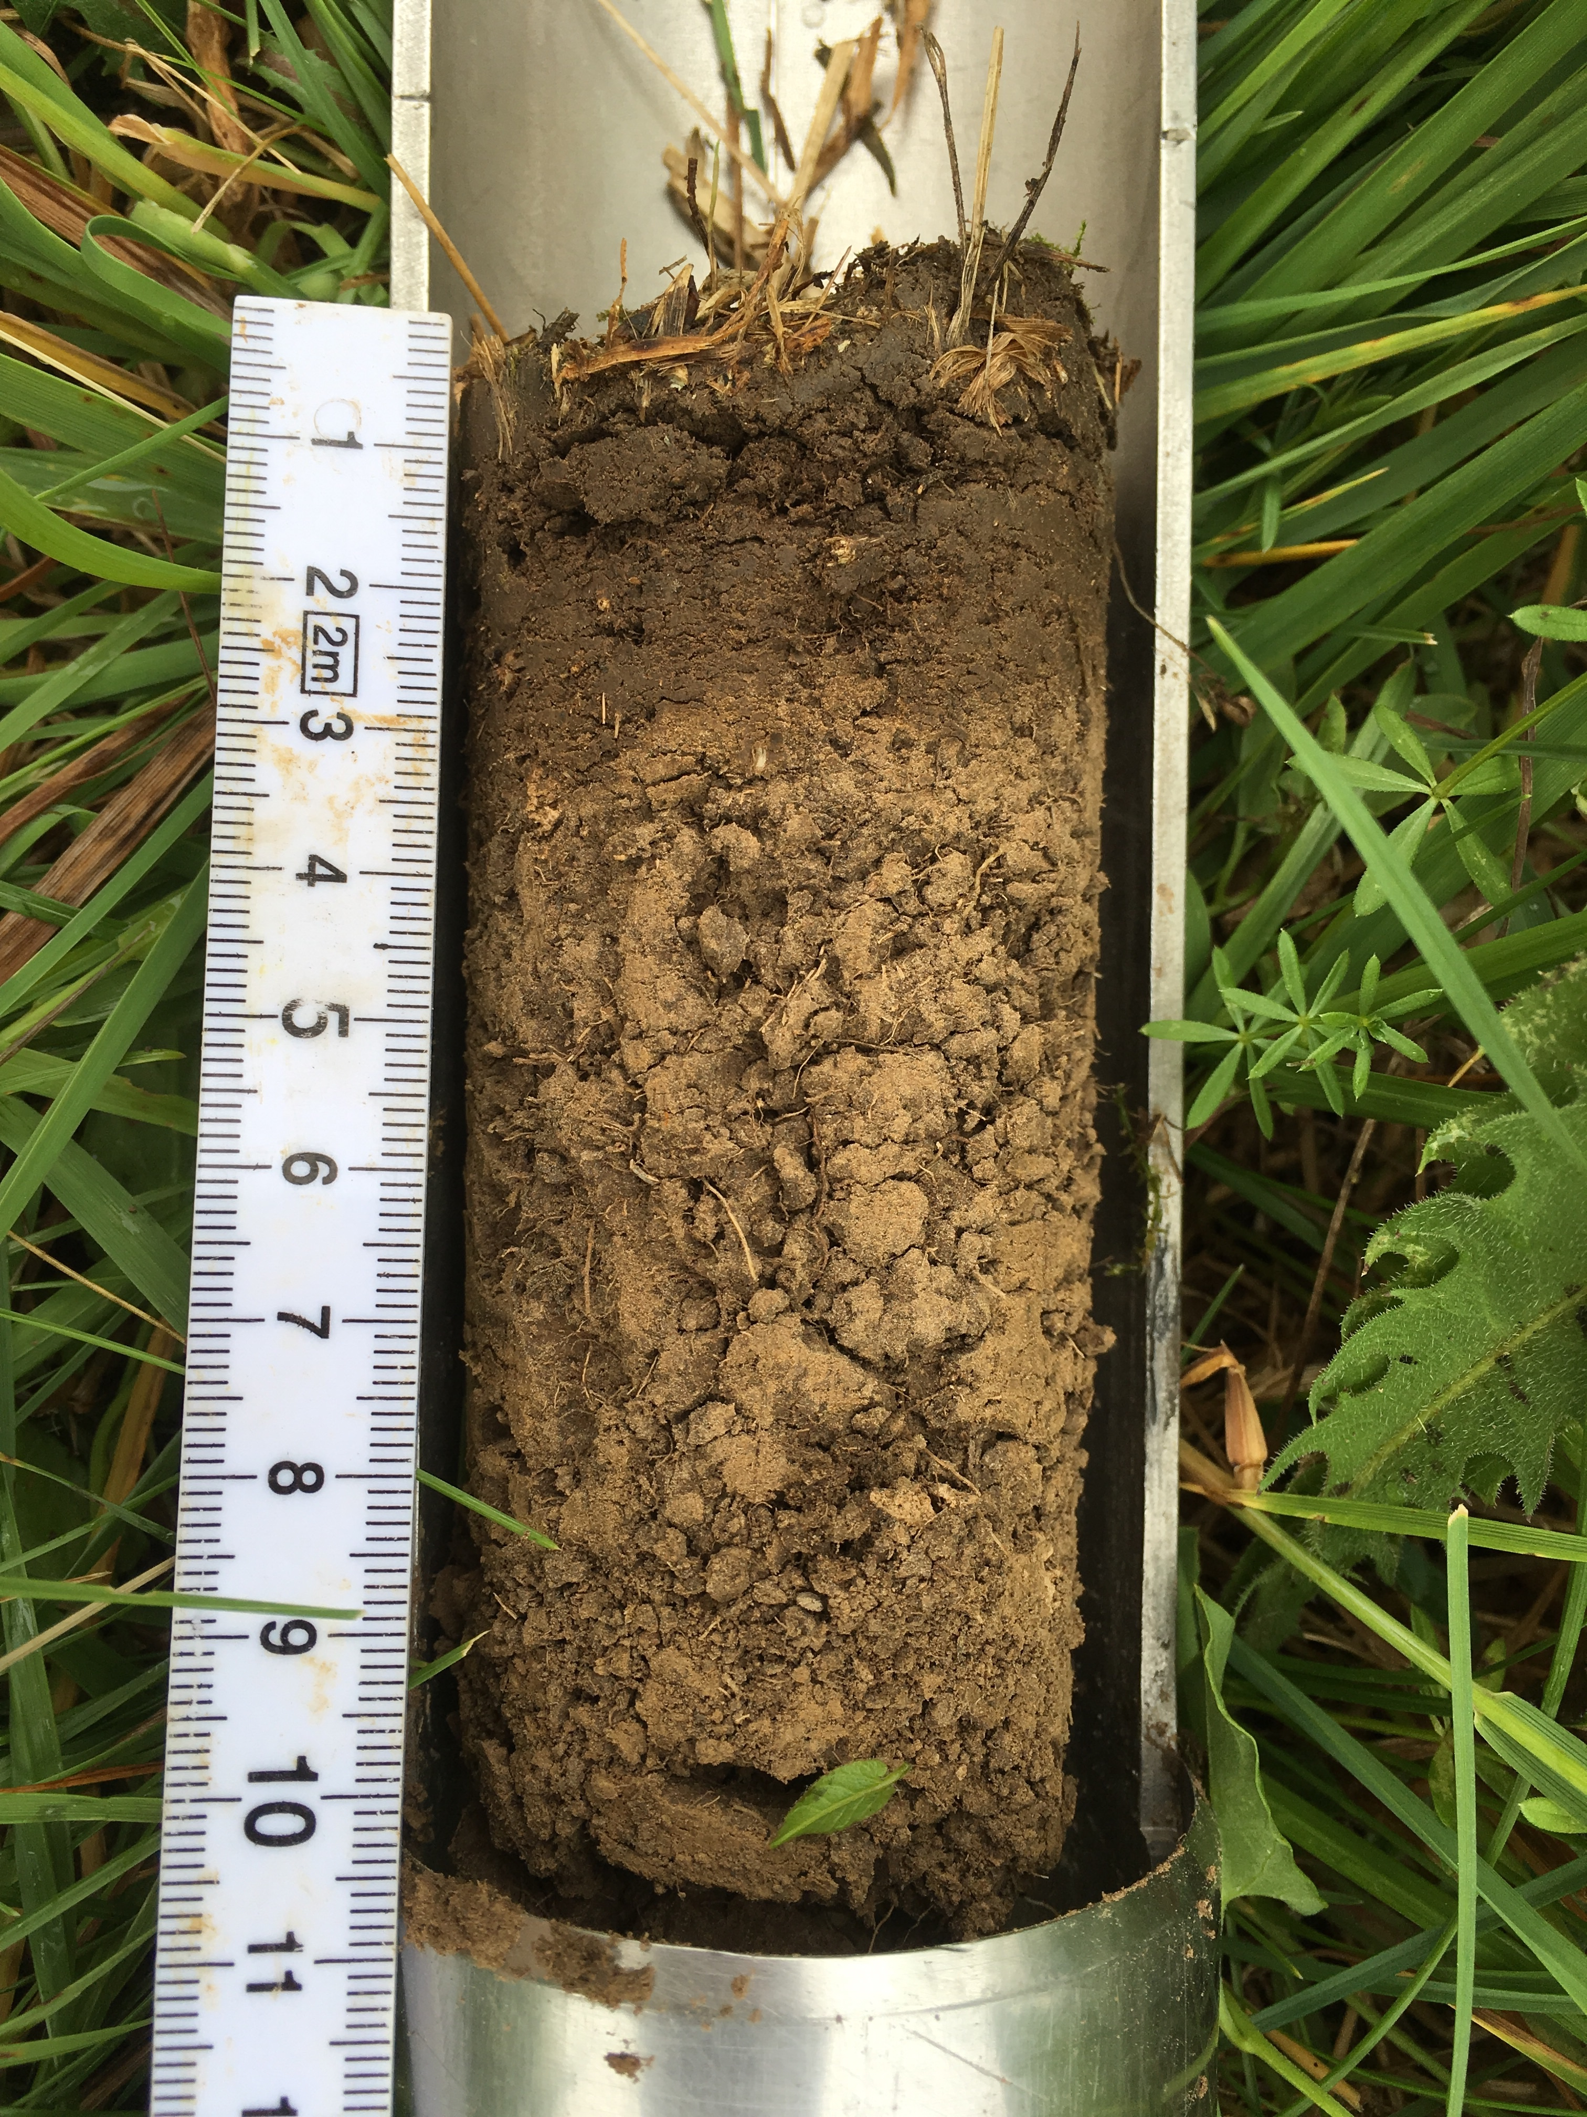
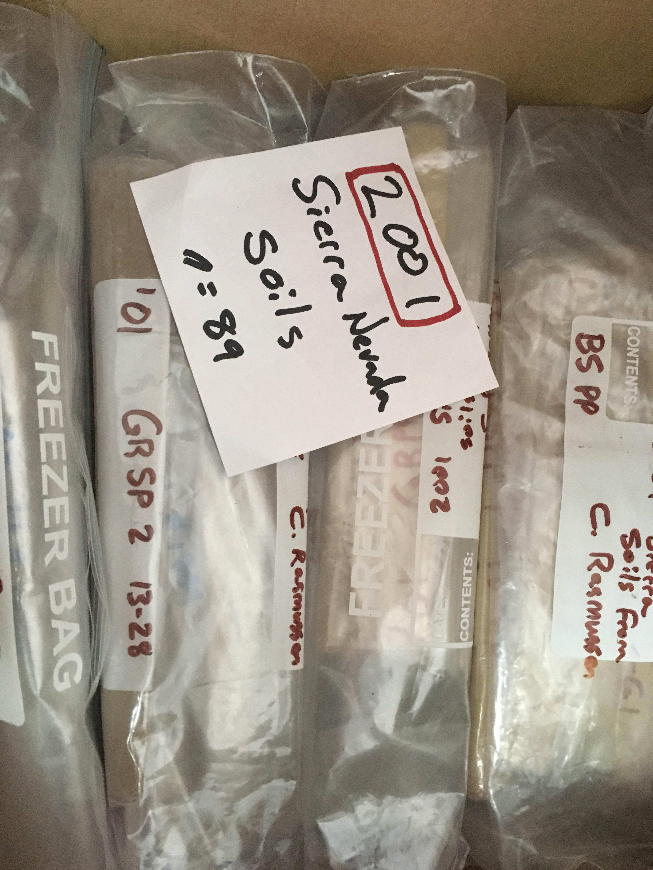
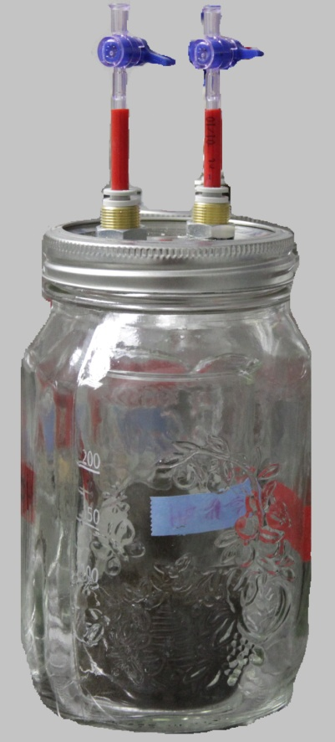
Radiocarbon incubations of archived soils
¹⁴Constraint Group Meeting
22 April, 2020
Jeff Beem-Miller
Insights into drying/rewetting effects and constraining soil C models
Notes:
update plots at end (get rid of erroneous CN data plot)
standardize plot labels and difference convention (i.e. final-initial, vs. initial-final)

Slide 2
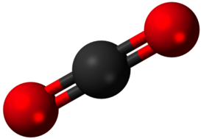

I. Why radiocarbon incubations of archived soil?
Why radiocarbon incubations?
Fractionate soils in a biologically meaningful way
heterotrophic respiration
DECADE
YEAR
CENTURY+
litter, exudates
Schematic of soil carbon model with pools characterized by different age distributions

Slide 3
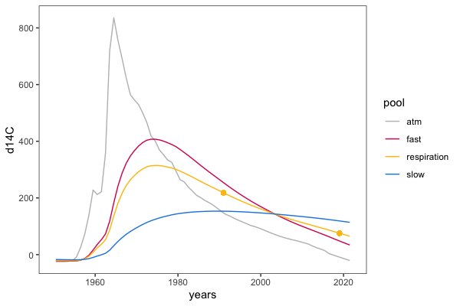
I. Why radiocarbon incubations of archived soil?
Why incubate archived soils?
Provide additional time point for improving model constraints

Slide 4
II. Questions & hypotheses
Hypotheses
Drying/rewetting will lead to increased ∆¹⁴C immediately following rewetting (pre-incubation), but will not affect ∆¹⁴C of the main incubation period.
Long-term storage will not affect the radiocarbon signature of heterotrophic respiration.

Slide 5
III. Methods
Sample selection:
Site | Country | Years Archived | n
Hainich | Germany | 7 | 12
Schorfheide-Chorin | Germany | 7 | 6
Musick, CA | USA | 9 | 1
Shaver, CA | USA | 9 | 1
Duke Forest, NC | USA | 10 | 1
Tennessee Valley, TN | USA | 14 | 4
Walker Branch, TN | USA | 14 | 5
Harvard Forest, MA | USA | 19 | 4
Total: |  |  | 34
All samples previously incubated, ¹⁴C-CO₂ measured
New incubations run on split of archived sample (i.e. not previously incubated)
Samples with inorganic C excluded
9 grassland, 25 forest sites; range of C content and texture
Notes:
Challenges:
¹⁴C incubations not common
Details of incubation not always available
Need a range of storage times; range of ¹⁴C-CO₂ content

Slide 6
III. Methods
Sample selection: Experiment 1
Site | Country | Years Archived | n
Hainich | Germany | 7 | 12
Schorfheide-Chorin | Germany | 7 | 6
Musick, CA | USA | 9 | 1
Shaver, CA | USA | 9 | 1
Duke Forest, NC | USA | 10 | 1
Tennessee Valley, TN | USA | 14 | 4
Walker Branch, TN | USA | 14 | 5
Harvard Forest, MA | USA | 19 | 4
Total: |  |  | 34
6
All samples previously incubated, ¹⁴C-CO₂ measured
New incubations run on split of archived sample (i.e. not previously incubated)
Samples with inorganic C excluded
9 grassland, 21 forest sites; range of C content and texture
Notes:
Challenges:
¹⁴C incubations not common
Details of incubation not always available
Need a range of storage times

Slide 7
III. Methods
Sample selection: Experiment 2
Site | Country | Years Archived | n
Hainich | Germany | 7 | 12
Schorfheide-Chorin | Germany | 7 | 6
Musick, CA | USA | 9 | 1
Shaver, CA | USA | 9 | 1
Duke Forest, NC | USA | 10 | 1
Tennessee Valley, TN | USA | 14 | 4
Walker Branch, TN | USA | 14 | 5
Harvard Forest, MA | USA | 19 | 4
Total: |  |  | 34
6
All samples previously incubated, ¹⁴C-CO₂ measured
New incubations run on split of archived sample (i.e. not previously incubated)
Samples with inorganic C excluded
9 grassland, 21 forest sites; range of C content and texture
Notes:
Challenges:
¹⁴C incubations not common
Details of incubation not always available
Need a range of storage times

Slide 8
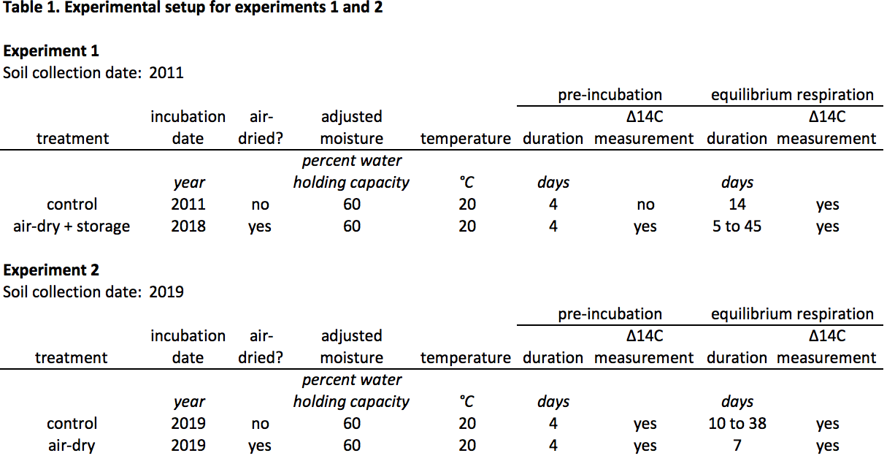
III. Methods
Experimental design:
Notes:
Challenges:
¹⁴C incubations not common
Details of incubation not always available
Need a range of storage times

Slide 9
III. Methods
Experimental design:
Notes:
Challenges:
¹⁴C incubations not common
Details of incubation not always available
Need a range of storage times

Slide 10
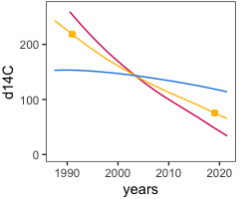
Conceptual plot (2)
Inset shows potential shifts in ¹⁴C-CO₂ in response to treatment (relative to control)
Direction of shift implies changes in the relative contribution of soil C pools with different intrinsic cycling rates (e.g. “fast” or “slow”) to respiration
respiration (measured)
•
+
control
+
greater slow C contribution
greater fast C contribution
+
pool (modeled)
Notes:
600x400
inset: 250x200
add additional conceptual figure for archive inc rationale (fig 1), i.e. two time points
make HR curve solid and purple
E50000, B700D2, 0030BF

Slide 11
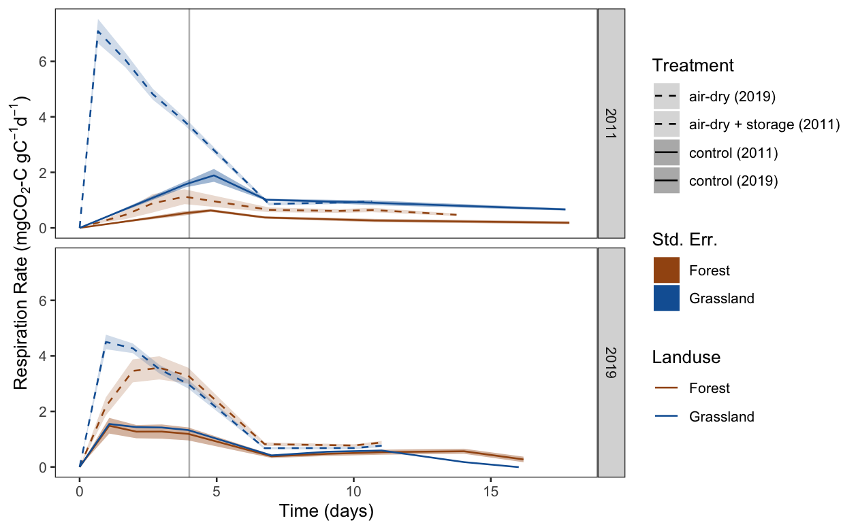
Treatment effect on respiration rate
Notes:
800x500
updated 22-Apr-2020

Slide 12
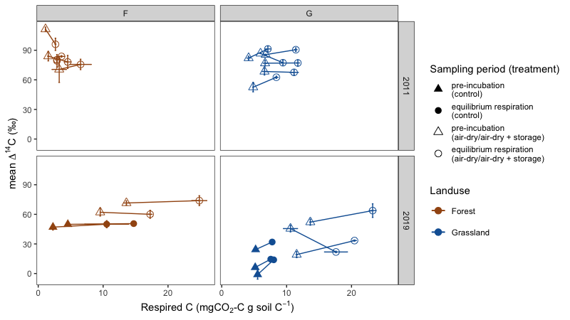
Rewetting pulse versus equilibrium respiration ∆¹⁴C-CO₂
(by fraction (‰) of soil C pool respired)
No trend in ∆¹⁴C-CO₂ with increasing respiration for forests or grasslands in 2011, nor forests in 2019; increasing trend for grassland 2019 except HEG10 (decline---slower C dyn)
Notes:
800x450

Slide 13
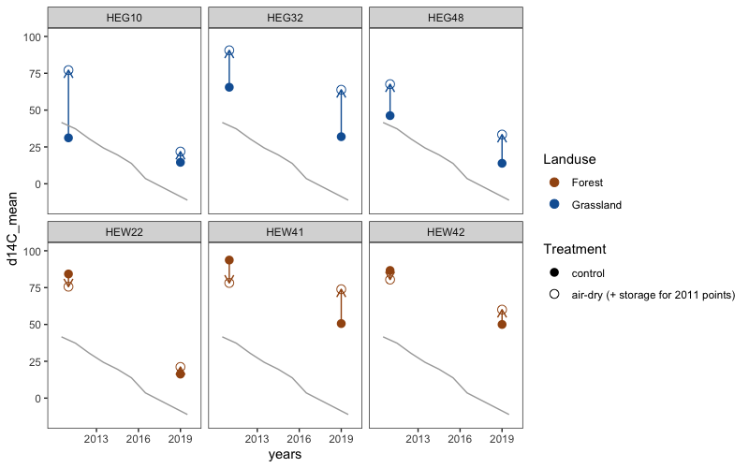
Shift in ∆¹⁴C-CO₂ due to treatment, over time
(both control and treatment samples, equilibrium respiration period from 2011 and 2019)
Notes:
narrative themes:
drying/rewetting; + storage; pre-inc; C-respired; interactions...
context: F/G, archive incubations

Slide 14
IV. Results: Experiment 2
Before and after archiving, all samples (∆¹⁴C ‰)
R² = 0.93
y = 0.59 + 0.84x
p < 0.0001
Notes:
Overall, pretty good?
updated 6 Feb 2020

Slide 15
IV. Results: Experiment 2
Duration of storage, all samples (∆¹⁴C ‰)
t_{final} - t_{initial} (∆¹⁴C ‰)
Notes:
Note that the point at 15 years were exposed to label...
Error bars are ±SEM
updated 6 Feb 2020

Slide 16
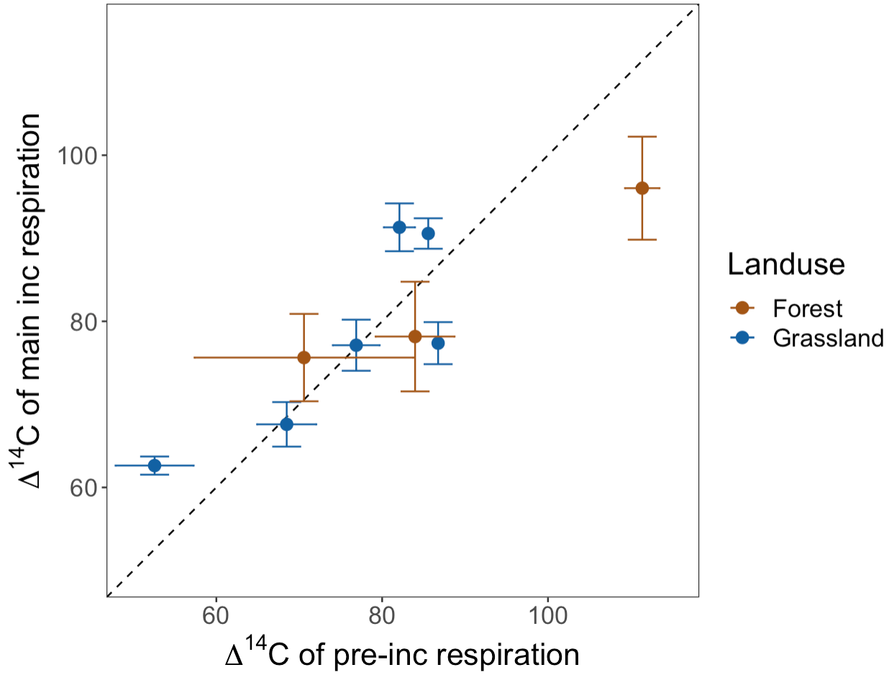
Alternative plot: 1:1 line for pre/equilibrium differences
(both control and treatment samples, equilibrium respiration period from 2011)
Notes:
* need to add rewet data

